Slide 1

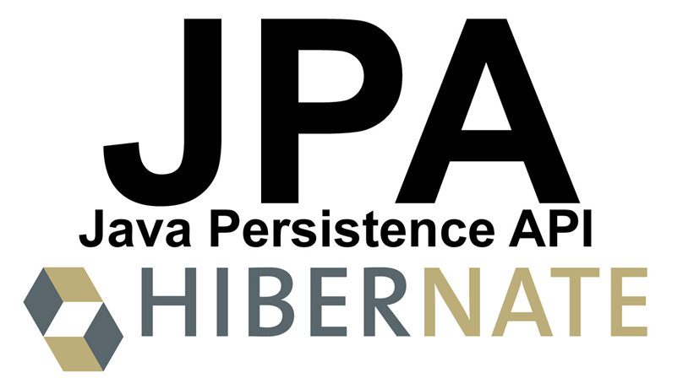

EJB (Enterprise Java Beans) JPA (Java Persistence API)
EJB, Java ORM, JPA and Hibernate CRUD Operations with JPA
EJB and JPA
Georgi Novakov
Develop Soft CEO
Software University
http://softuni.bg

Slide 2



Table of Contents
EJB
ORM Frameworks
JPA (Java Persistence API)
Install and Configure JPA
Mapping the DB Schema with JPA Annotations
CRUD Operations
Query Entities
Create, Update, Delete Entities

Slide 3
What is EJB
Enterprise beans are Java EE components that implement Enterprise JavaBeans (EJB) technology
A server-side component that encapsulates the business logic of an application
Enterprise beans run in the EJB container

Slide 4
EJB Benefits
Simplified development of large scale enterprise level application.
Application Server/ EJB container provides most of the system level services like transaction handling, logging, load balancing, persistence mechanism, exception handling and so on. Developer has to focus only on business logic of the application.
EJB container manages life cycle of ejb instances thus developer needs not to worry about when to create/delete ejb objects

Slide 5
General responsibilities
The EJB specification details how an application server provides the following responsibilities:
Transaction processing
Integration with the persistence services offered by the Java Persistence API (JPA)
Concurrency control
Event-driven programming using Java Message Service and Java EE Connector Architecture
Asynchronous method invocation
Job scheduling
Naming and directory services (JNDI)
Interprocess Communication using RMI-IIOP and Web services
Security (JCE and JAAS)
Deployment of software components in an application server

Slide 6
EJB Types
Type | Description
Session Bean | Session bean stores data of a particular user for a single session. It can be stateful or stateless. It is less resource intensive as compared to entity beans. Session bean gets destroyed as soon as user session terminates.
Entity Bean | Entity beans represents persistent data storage. User data can be saved to database via entity beans and later on can be retrived from the database in the entity bean.
Message Driven Bean | Message driven beans are used in context of JMS (Java Messaging Service). Message Driven Beans can consumes JMS messages from external entities and act accordingly.

Slide 7
What Is a Session Bean?
A session bean encapsulates business logic that can be invoked programmatically by a client over local, remote, or web service client views. To access an application that is deployed on the server, the client invokes the session bean’s methods. The session bean performs work for its client, shielding it from complexity by executing business tasks inside the server.
A session bean is not persistent. (That is, its data is not saved to a database.)

Slide 8
Stateful Session Beans
The state of an object consists of the values of its instance variables.
A session bean is similar to an interactive session
In a stateful session bean, the instance variables represent the state of a unique client/bean session
A session bean is not shared; it can have only one client
The state is retained for the duration of the client/bean session

Slide 9
Stateful Session Beans - Example
@Stateful
@StatefulTimeout(unit = TimeUnit.MINUTES, value = 30)
public class ShoppingCartBean implements ShoppingCart {
@PersistenceContext
private EntityManager em;
private List<Product> products;
@PostConstruct
private void init(){
products = new ArrayList<>();
}
@Override
public void addProduct(Product product){
products.add(product);
}
@Override
@TransactionAttribute(TransactionAttributeType.REQUIRED)
public void completePurchase(){
for(Product product : products){
em.persist(product);
}
products.clear();
}
}

Slide 10
Stateless Session Beans
A stateless session bean does not maintain a conversational state with the client.
The bean’s instance variables may contain a state specific to that client but only for the duration of the invocation
When the method is finished, the client-specific state should not be retained

Slide 11
Stateless Session Beans - Example
@Stateless
public class UserServiceImpl extends BaseServiceBeanImpl<UserModel> implements UserService {
@EJB
protected UserDao userDao;
public UserServiceImpl() {
super();
}
@SuppressWarnings("unchecked")
protected UserDao getDao() {
return userDao;
}
@Override
public List<UserModel> findAllUsers() {
return getDao().findAllUsers();
}
@Override
public UserModel loginUser(String aUsername, String aPassword) {
return getDao().loginUser(aUsername, aPassword);
}
@Override
public boolean checkUserExists(String username, Long id) {
UserModel user = getDao().checkUserExists(username, id);
return user != null && user.getId() != null;
}

Slide 12
Stateless Session Beans
Clients may, however, change the state of instance variables in pooled stateless beans, and this state is held over to the next invocation of the pooled stateless bean
Except during method invocation, all instances of a stateless bean are equivalent, allowing the EJB container to assign an instance to any clien
A stateless session bean can implement a web service, but a stateful session bean cannot.

Slide 13
Singleton Session Beans
A singleton session bean is instantiated once per application and exists for the lifecycle of the application.
Singleton session beans maintain their state between client invocations but are not required to maintain their state across server crashes or shutdowns.

Slide 14
Message-Driven Beans
A message-driven bean is an enterprise bean that allows Java EE applications to process messages asynchronously.
Normally acts as a JMS message listener, which is similar to an event listener but receives JMS messages instead of events
The messages can be sent by any Java EE component (an application client, another enterprise bean, or a web component) or by a JMS application or system that does not use Java EE technology
Message-driven beans can process JMS messages or other kinds of messages.

Slide 15
Message-Driven Beans
A message-driven bean’s instances retain no data or conversational state for a specific client.
All instances of a message-driven bean are equivalent, allowing the EJB container to assign a message to any message-driven bean instance.
A single message-driven bean can process messages from multiple clients.
Client components do not locate message-driven beans and invoke methods directly on them.

Slide 16
Message-driven beans have the following characteristics.
They execute upon receipt of a single client message.
They are invoked asynchronously.
They are relatively short-lived.
They do not represent directly shared data in the database, but they can access and update this data.
They can be transaction-aware.
They are stateless.

Slide 17
Message-driven Beans - Example
@MessageDriven(
activationConfig =
{
@ActivationConfigProperty(propertyName = "destinationType",
propertyValue = "javax.jms.Queue"),
@ActivationConfigProperty(propertyName = "destination",
propertyValue = "queue/MyQueue")
})
public class QueueListenerMDB implements MessageListener {
public QueueListenerMDB() { … }
public final void onMessage(Message message){
try {
if (message instanceof TextMessage) {
System.out.println("Queue: I received a TextMessage at “ + new Date());
TextMessage msg = (TextMessage) message;
System.out.println("Message is : " + msg.getText());
} else if (message instanceof ObjectMessage) {
System.out.println("Queue: I received an ObjectMessage at " + new Date());
ObjectMessage msg = (ObjectMessage) message;
Employee employee = (Employee) msg.getObject();
System.out.println(employee.getName());
} else {
System.out.println("Not valid message for this Queue MDB");
}
} catch (JMSException e) {
e.printStackTrace();
}
}
}

Slide 18
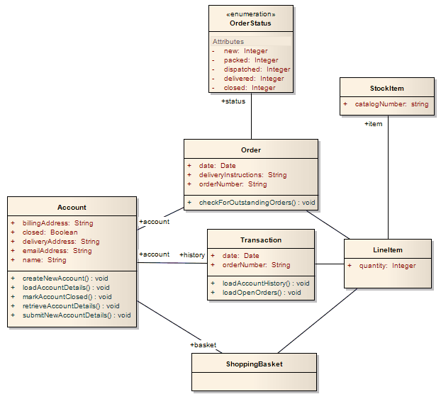
Entity Beans
Typically, an entity represents a table in a relational database
Each entity instance corresponds to a row in that table

Slide 19
Contexts and Dependency Injection (CDI)
CDI is a set of services that, used together, make it easy for developers to use enterprise beans along with JavaServer Faces technology in web applications
The most fundamental services provided by CDI are as follows:
Contexts: The ability to bind the lifecycle and interactions of stateful components to well-defined but extensible lifecycle contexts
Dependency injection: The ability to inject components into an application in a typesafe way, including the ability to choose at deployment time which implementation of a particular interface to inject
Integration with the Expression Language (EL), which allows any component to be used directly within a JavaServer Faces page or a JavaServer Pages page
A web conversation scope in addition to the three standard scopes (request, session, and application) defined by the Java Servlet specification

Slide 20
Dependency injection and inversion of control
Dependency injection is supported only on managed classes and not on regular POJO.
@EJB - used to inject other EJB reference. (@EJB(name="BidManagerRemote"))
@Resource - used to inject datasource or singleton services like sessionContext, timerService etc. (@Resource(name="jdbc/ActionBazaarDB"))
@Inject – used to inject any bean. Does not support parameters (private @Inject ShoppingCart cart;)

Slide 21
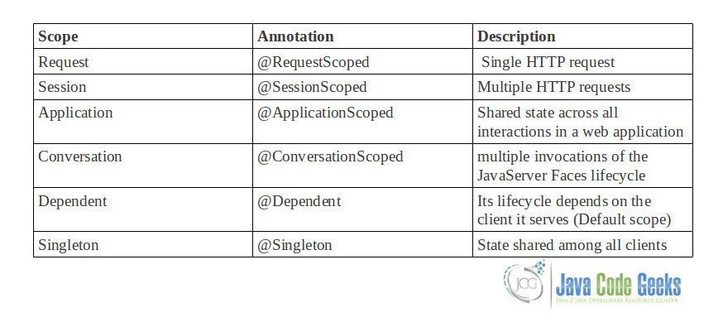
CDI bean scopes
https://www.javacodegeeks.com/2013/04/java-ee-cdi-bean-scopes.html

Slide 22
Valid CDI scopes for Session (EJB) beans
CDI enriches the EJB specification by providing contextual life cycle management
Stateful EJBs can have any scope – no restrictions whatsoever!
Stateless beans can only belong to the @Dependent scope
//This is valid
@Stateless
@Dependent
public class EJB1 {
@PostConstruct
public void init(){
System.out.println(EJB1.class.getName() + " constructed successfully on "+ new Date().toString());
}
}
//This is NOT valid
@Stateless
@RequestScoped
public class EJB1 {
@PostConstruct
public void init(){
System.out.println(EJB1.class.getName() + " constructed successfully on "+ new Date().toString());
}
}
https://abhirockzz.wordpress.com/2015/02/19/valid-cdi-scoped-for-session-ejb-beans/

Slide 23
Valid CDI scopes for Session (EJB) beans
With Singleton beans, @ApplicationScoped is the only valid CDI scope (@Dependent is the default in case you do not use any other explicit CDI scope)
//This is legal
@Singleton
@Startup
@ApplicationScoped
public class Singleton1 {
@PostConstruct
public void init(){
System.out.println(Singleton1.class.getName() + " constructed successfully on "+ new Date().toString());
}
}
//CDI container will not be happy seeing this
@Singleton
@Startup
@RequestScoped
public class Singleton1 {
@PostConstruct
public void init(){
System.out.println(Singleton1.class.getName() + " constructed successfully on "+ new Date().toString());
}
}

Slide 24
Accessing Enterprise Beans
Accessing EJBs applies only to session beans and not to message-driven beans.
Message-driven beans have a different programming model
Message-driven beans do not have interfaces or no-interface views that define client access.

Slide 25
Accessing Enterprise Beans
Clients access enterprise beans either through a no-interface view or through a business interface.
A no-interface view of an enterprise bean exposes the public methods of the enterprise bean implementation class to clients. Clients using the no-interface view of an enterprise bean may invoke any public methods in the enterprise bean implementation class or any superclasses of the implementation class
A business interface is a standard Java programming language interface that contains the business methods of the enterprise bean.

Slide 26
Using Enterprise Beans in Clients
The client of an enterprise bean obtains a reference to an instance of an enterprise bean through either dependency injection, using Java programming language annotations, or JNDI lookup, using the Java Naming and Directory Interface syntax to find the enterprise bean instance.
Dependency injection – available in Java EE server-managed environment, JavaServer Faces web applications, JAX-RS web services, other enterprise beans, or Java EE application clients
JNDI - used in non JEE environment

Slide 27
Portable JNDI Syntax
The java:global JNDI namespace is the portable way of finding remote enterprise beans using JNDI lookups. JNDI addresses are of the following form:
java:global[/application name]/module name/enterprise bean name[/interface name]
Application name and module name default to the name of the application and module minus the file extension. Application names are required only if the application is packaged within an EAR. The interface name is required only if the enterprise bean implements more than one business interface.
The java:module namespace is used to look up local enterprise beans within the same module. JNDI addresses using the java:module namespace are of the following form:
java:module/enterprise bean name/[interface name]
The interface name is required only if the enterprise bean implements more than one business interface.
The java:app namespace is used to look up local enterprise beans packaged within the same application. That is, the enterprise bean is packaged within an EAR file containing multiple Java EE modules. JNDI addresses using the java:app namespace are of the following form:
java:app[/module name]/enterprise bean name[/interface name]

Slide 28
Portable JNDI Syntax
import javax.naming.InitialContext;
import javax.naming.NamingException;
import com.developsoft.service.ConfigParamService;
import com.developsoft.service.UserService;
public class JndiHelper {
public static final String CONFIG_PARAMS_JNDI = "java:app/SoftUniJEE-ejb/ConfigParamServiceImpl!com.developsoft.service.ConfigParamService";
public static final String USER_SERVICE_JNDI = "java:app/SoftUniJEE-ejb/UserServiceImpl!com.developsoft.service.UserService";
public static Object lookupLocal(String jndiBinding) {
InitialContext ctx;
try {
ctx = new InitialContext();
Object obj = ctx.lookup(jndiBinding);
return obj;
} catch (NamingException e) {
e.printStackTrace();
}
return null;
}
public static ConfigParamService lookupConfigParamService() {
return (ConfigParamService) JndiHelper.lookupLocal(CONFIG_PARAMS_JNDI);
}
public static UserService lookupUserService() {
return (UserService) JndiHelper.lookupLocal(USER_SERVICE_JNDI);
}
}

Slide 29
Local Clients
It must run in the same application as the enterprise bean it accesses and can be a web component or another enterprise bean
To build an enterprise bean that allows only local access, you may, but are not required to, do one of the following:
Create an enterprise bean implementation class that does not implement a business interface, indicating that the bean exposes a no-interface view to clients.
@Session
public class MyBean { ... }
Annotate the business interface of the enterprise bean as a @Local interface.
@Local
public interface InterfaceName { ... }
Specify the interface by decorating the bean class with @Local and specify the interface name.
@Local(InterfaceName.class)
public class BeanName implements InterfaceName { ... }

Slide 30
Accessing Local Enterprise Beans Using the No-Interface View
To obtain a reference to the no-interface view of an enterprise bean through DEPENDENCY INJECTION, use the javax.ejb.EJB annotation and specify the enterprise bean’s implementation class:
@EJB
ExampleBean exampleBean;
To obtain a reference to the no-interface view of an enterprise bean through JNDI lookup, use the javax.naming.InitialContext interface’s lookup method:
ExampleBean exampleBean = (ExampleBean) InitialContext.lookup("java:module/ExampleBean");
Points to the EJB
Points to the EJB

Slide 31
Accessing Local Enterprise Beans That Implement Business Interfaces
To obtain a reference to the local business interface of an enterprise bean through DEPENDENCY INJECTION, use the javax.ejb.EJB annotation and specify the enterprise bean’s local business interface name:
@EJB
ExampleLocal example;
To obtain a reference to a local business interface of an enterprise bean through JNDI lookup, use the javax.naming.InitialContext interface’s lookup method:
ExampleLocal example = (ExampleLocal) InitialContext.lookup("java:module/ExampleLocal");
Points to the Interface
Points to the Interface

Slide 32
Remote Clients
It can run on a different machine and a different JVM from the enterprise bean it accesses. (It is not required to run on a different JVM.)
It can be a web component, an application client, or another enterprise bean.
To a remote client, the location of the enterprise bean is transparent.
The enterprise bean must implement a business interface. That is, remote clients may not access an enterprise bean through a no-interface view.

Slide 33
Define remote interface
Decorate the business interface of the enterprise bean with the @Remote annotation:
@Remote
public interface InterfaceName { ... }
Decorate the bean class with @Remote, specifying the business interface or interfaces:
@Remote(InterfaceName.class)
public class BeanName implements InterfaceName { ... }

Slide 34
Access remote EJB
To obtain a reference to the remote business interface of an enterprise bean through dependency injection, use the javax.ejb.EJB annotation and specify the enterprise bean’s remote business interface name:
@EJB
ExampleRemote example;
To obtain a reference to a remote business interface of an enterprise bean through JNDI lookup, use the javax.naming.InitialContext interface’s lookup method:
ExampleRemote example = (ExampleRemote) InitialContext.lookup("java:global/myApp/ExampleRemote");

Slide 35
Access remote EJB – extra config needed
Define remote server configuration
// jboss-ejb-client.properties
endpoint.name=client-endpoint
remote.connectionprovider.create.options.org.xnio.Options.SSL_ENABLED=false
remote.connections=default
remote.connection.default.host=10.20.30.40
remote.connection.default.port = 4447
remote.connection.default.username=appuser
remote.connection.default.password=apppassword
// jboss-ejb-client.properties
remote.connectionprovider.create.options.org.xnio.Options.SSL_ENABLED=false
remote.connections=one, two
remote.connection.one.host=localhost
remote.connection.one.port=6999
remote.connection.two.host=localhost
remote.connection.two.port=7999

Slide 36
Web Service Clients
import javax.ejb.Stateless;
import javax.jws.WebMethod;
import javax.jws.WebService;
@Stateless
@WebService
public class HelloServiceBean {
private String message = "Hello, ";
public void HelloServiceBean() {}
@WebMethod
public String sayHello(String name) {
return message + name + ".";
}
}

Slide 37
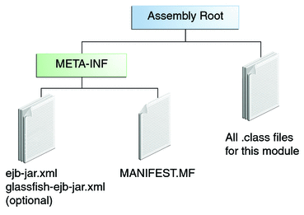
Packaging EJBs
An EJB JAR file is portable and can be used for various applications.

Slide 38
Naming Conventions for Enterprise Beans
Item | Syntax | Example
Enterprise bean name | nameBean | AccountBean
Enterprise bean class | nameBean | AccountBean
Business interface | name | Account

Slide 39
EJB Pooling and Caching
Bean Type | Pooled | Cached
Stateless Session | Yes | No
Stateful Session | No | Yes
Entity | Yes | Yes
Tuning the EJB Pool https://docs.oracle.com/cd/E19159-01/819-3681/abeee/index.html
Notes:
The difference between a pooled bean and a cached bean is that pooled beans are all equivalent and indistinguishable from one another. Cached beans, on the contrary, contain conversational state in the case of stateful session beans, and are associated with a primary key in the case of entity beans. Entity beans are removed from the pool and added to the cache on ejbActivate() and removed from the cache and added to the pool onejbPassivate(). ejbActivate() is called by the container when a needed entity bean is not in the cache. ejbPassivate() is called by the container when the cache grows beyond its configured limits.

Slide 40
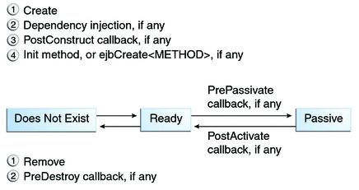
The Lifecycle of a Stateful Session Bean
Typically, the EJB container uses a least-recently-used algorithm to select a bean for passivation.
At the end of the lifecycle, the client invokes a method annotated @Remove, and the EJB container calls the method annotated @PreDestroy, if any. The bean’s instance is then ready for garbage collection.
Your code controls the invocation of only one lifecycle method: the method annotated @Remove. All other methods in the figure are invoked by the EJB container.

Slide 41
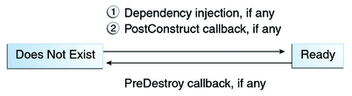
The Lifecycle of a Stateless Session Bean
Because a stateless session bean is never passivated, its lifecycle has only two stages: nonexistent and ready for the invocation of business methods.

Slide 42
The Lifecycle of a Singleton Session Bean
Like a stateless session bean, a singleton session bean is never passivated and has only two stages, nonexistent and ready for the invocation of business methods

Slide 43
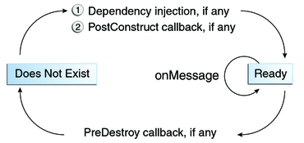
The Lifecycle of a Message-Driven Bean
Like a stateless session bean, a message-driven bean is never passivated and has only two states: nonexistent and ready to receive messages.
Notes:
http://docs.oracle.com/javaee/6/tutorial/doc/giplj.html

Slide 44
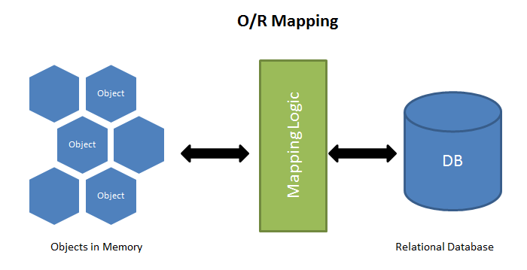
ORM Frameworks – Overview
ORM Frameworks map OOP classes to database tables

Slide 45
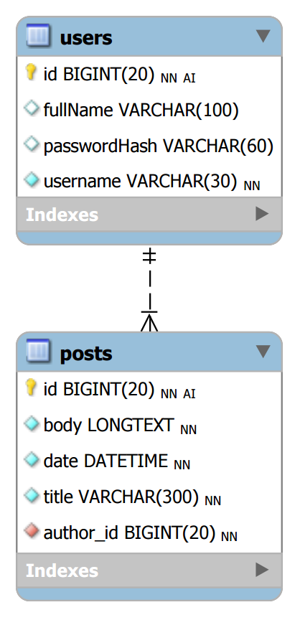
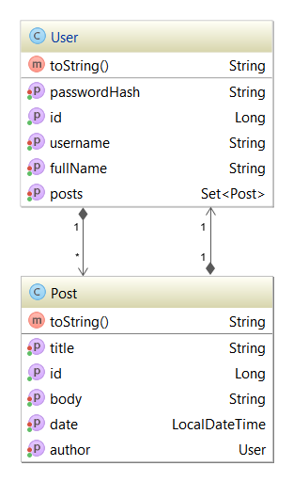




Mapping DB Tables to Classes
Relational DB Schema
ORM
Framework
Java Entity Classes

Slide 46
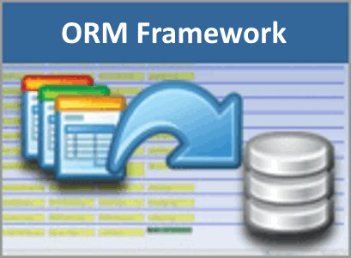
ORM Frameworks – Features
Java classes are mapped to DB tables
DB relationships are mapped to class associations
ORM provides API for CRUD operations
List objects / query database
Create new object
Update existing object
Delete existing object
Some ORMs provide schema synchronization (DB migrations)
CRUD operations execute
SQL commands in the DB

Slide 47
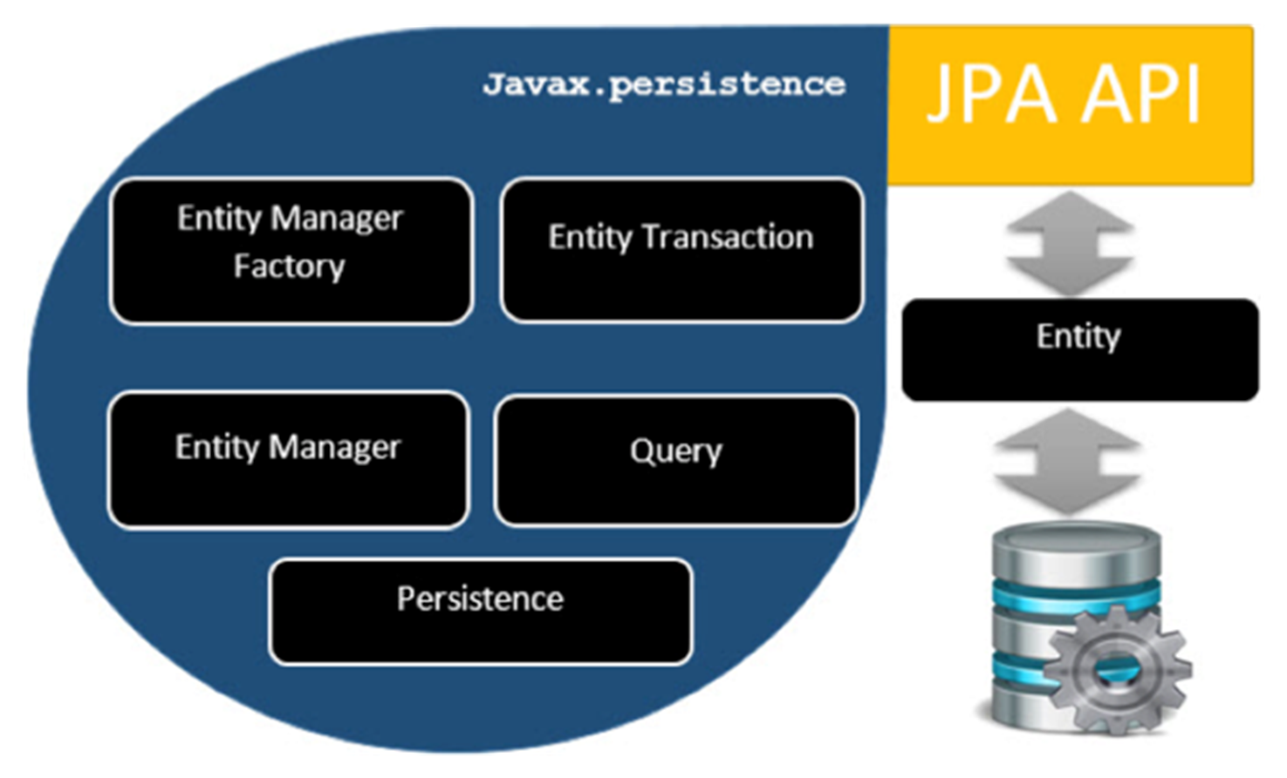
JPA – Java Persistence API

Slide 48
Java Persistence API
JPA provides Java developers with an object/relational mapping facility for managing relational data in Java applications.
Java Persistence consists of four areas:
The Java Persistence API
The query language
The Java Persistence Criteria API
Object/relational mapping metadata
JPA Providers
JPA is an open source API, therefore various enterprise vendors such as Oracle, Redhat, Eclipse, etc. provide new products by adding the JPA persistence flavor in them. Some of these products include:
Hibernate, Eclipselink, Toplink, Spring Data JPA, Open JPA, etc

Slide 49
Requirements for Entity Classes
The class must be annotated with the javax.persistence.Entity annotation.
The class must have a public or protected, no-argument constructor. The class may have other constructors.
The class must not be declared final. No methods or persistent instance variables must be declared final.
If an entity instance is passed by value as a detached object, such as through a session bean’s remote business interface, the class must implement the Serializable interface.
Entities may extend both entity and non-entity classes, and non-entity classes may extend entity classes.
Persistent instance variables must be declared private, protected, or package-private and can be accessed directly only by the entity class’s methods. Clients must access the entity’s state through accessor or business methods.

Slide 50
Persistent Fields and Properties
Persistent Fields
The Persistence runtime accesses entity-class instance variables directly.
All fields not annotated javax.persistence.Transient or not marked as Java transient will be persisted to the data store.
The object/relational mapping annotations must be applied to the instance variables.
Persistent Properties
The entity must follow the method conventions of JavaBeans components
Must have getters and setters (getProperty, setProperty, isProperty)
The object/relational mapping annotations for persistent properties must be applied to the getter methods
Mapping annotations cannot be applied to fields or properties annotated @Transient or marked transient.

Slide 51
Validating Persistent Fields and Properties
@Entity
public class Contact implements Serializable {
private static final long serialVersionUID = 1L;
@Id
@GeneratedValue(strategy = GenerationType.AUTO)
private Long id;
@NotNull
protected String firstName;
@NotNull
protected String lastName;
@Pattern(regexp="[a-z0-9!#$%&'*+/=?^_`{|}~-]+(?:\\."
+"[a-z0-9!#$%&'*+/=?^_`{|}~-]+)*@"
+"(?:[a-z0-9](?:[a-z0-9-]*[a-z0-9])?\\.)+[a-z0-9](?:[a-z0-9-]*[a-z0-9])?",
message="{invalid.email}")
protected String email;
@Pattern(regexp="^\\(?(\\d{3})\\)?[- ]?(\\d{3})[- ]?(\\d{4})$",
message="{invalid.phonenumber}")
protected String mobilePhone;
@Pattern(regexp="^\\(?(\\d{3})\\)?[- ]?(\\d{3})[- ]?(\\d{4})$",
message="{invalid.phonenumber}")
protected String homePhone;
@Temporal(javax.persistence.TemporalType.DATE)
@Past
protected Date birthday;
...
}

Slide 52
Primary Keys in Entities
Each entity has a unique object identifier called Primary Key
Simple or composite primary key (javax.persistence.Id, javax.persistence.EmbeddedId, javax.persistence.IdClass)
Floating-point types should never be used in primary keys
Java primitive types
Java primitive wrapper types
java.lang.String
java.util.Date (the temporal type should be DATE)
java.sql.Date
java.math.BigDecimal
java.math.BigInteger

Slide 53
Multiplicity in Entity Relationships
One-to-one: Each entity instance is related to a single instance of another entity. For example, to model a physical warehouse in which each storage bin contains a single widget, StorageBin and Widget would have a one-to-one relationship. One-to-one relationships use the javax.persistence.OneToOne annotation on the corresponding persistent property or field.
One-to-many: An entity instance can be related to multiple instances of the other entities. A sales order, for example, can have multiple line items. In the order application, Order would have a one-to-many relationship with LineItem. One-to-many relationships use the javax.persistence.OneToMany annotation on the corresponding persistent property or field.

Slide 54
Multiplicity in Entity Relationships
Many-to-one: Multiple instances of an entity can be related to a single instance of the other entity. This multiplicity is the opposite of a one-to-many relationship. In the example just mentioned, the relationship to Order from the perspective of LineItem is many-to-one. Many-to-one relationships use the javax.persistence.ManyToOne annotation on the corresponding persistent property or field.
Many-to-many: The entity instances can be related to multiple instances of each other. For example, each college course has many students, and every student may take several courses. Therefore, in an enrollment application, Course and Student would have a many-to-many relationship. Many-to-many relationships use the javax.persistence.ManyToMany annotation on the corresponding persistent property or field.

Slide 55
Cascade Operations and Relationships
Cascade Operation | Description
ALL | All cascade operations will be applied to the parent entity’s related entity. All is equivalent to specifying cascade={DETACH, MERGE, PERSIST, REFRESH, REMOVE}
DETACH | If the parent entity is detached from the persistence context, the related entity will also be detached.
MERGE | If the parent entity is merged into the persistence context, the related entity will also be merged.
PERSIST | If the parent entity is persisted into the persistence context, the related entity will also be persisted.
REFRESH | If the parent entity is refreshed in the current persistence context, the related entity will also be refreshed.
REMOVE | If the parent entity is removed from the current persistence context, the related entity will also be removed.

Slide 56
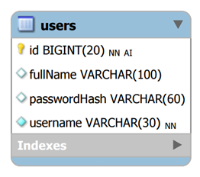
Entity Class: User
User.java
@Entity @Table(name = "users")
public class User {
@Id @GeneratedValue(strategy = GenerationType.IDENTITY)
private Long id;
@Column(nullable = false, length = 30, unique = true)
private String username;
@Column(length = 60)
private String passwordHash;
@Column(length = 100)
private String fullName;
@OneToMany(mappedBy = "author")
private Set<Post> posts = new HashSet<Post>();
}
Generate also getters / setters / toString()

Slide 57
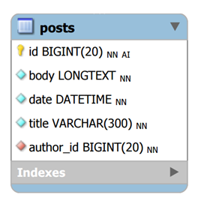
Entity Class: Post
Post.java
@Entity @Table(name = "posts")
public class Post {
@Id @GeneratedValue(strategy = GenerationType.IDENTITY)
private Long id;
@Column(nullable = false, length = 300)
private String title;
@Lob @Column(nullable = false)
private String body;
@ManyToOne(optional = false)
private User author;
@Column(nullable = false)
private LocalDateTime date = LocalDateTime.now();
}
Generate also getters / setters / toString()

Slide 58
Entity Manager
Container-Managed Entity Managers
Application-Managed Entity Managers
@PersistenceContext
EntityManager em;
@PersistenceContext
EntityManagerFactory emf;
EntityManager em;
@Resource
UserTransaction utx;
...
em = emf.createEntityManager();
try {
utx.begin();
em.persist(SomeEntity);
em.merge(AnotherEntity);
em.remove(ThirdEntity);
utx.commit();
} catch (Exception e) {
utx.rollback();
}

Slide 59

JPA – Java Persistence API
Persistence
import javax.persistence.*;
==
JPA
createEntityManagerFactory()
Query
EntityManagerFactory
setParameter()
getResultList()
getSingleResult()
executeUpdate()
Entity
Entity
Entity
createEntityManager()
id
field1
field2
id
field1
field2
id
field1
field2
EntityManager
EntityTransaction
getTransaction()
find() / createQuery()
persist()
remove()
begin()
commit()
rollback()

Slide 60
The JPA Configuration: persistence.xml
Create the JPA configuration file to connect to blog_db
resources\META-INF\persistence.xml
<persistence xmlns="http://xmlns.jcp.org/xml/ns/persistence" version="2.1">
<persistence-unit name="blog-db">
<properties>
<property name="javax.persistence.jdbc.driver" value="com.mysql.cj.jdbc.Driver" />
<property name="javax.persistence.jdbc.url" value="jdbc:mysql://localhost/blog_db" />
<property name="javax.persistence.jdbc.user" value="root" />
<property name="javax.persistence.jdbc.password" value="" />
<property name="hibernate.connection.characterEncoding" value="utf-8" />
<property name="hibernate.show_sql" value="false" />
<property name="hibernate.format_sql" value="true" />
<property name="hibernate.hbm2ddl.auto" value="create" />
</properties>
</persistence-unit>
</persistence>
Configure the DB connection string
Use "create" or "update"

Slide 61
The JPA Configuration: persistence.xml
Create the JPA configuration file to connect to blog_db
resources\META-INF\persistence.xml
<persistence >
<persistence-unit name="blog_db">
<jta-data-source>java:/blog_db</jta-data-source>
<properties>
<property name="jboss.entity.manager.jndi.name" value="java:/CRMTaryaDS" />
<property name="jboss.entity.manager.factory.jndi.name“ value="java:/Manager1Factory" />
<property name="hibernate.dialect" value="org.hibernate.dialect.MySQL5InnoDBDialect" />
<property name="hibernate.show_sql" value="true" />
<property name="hibernate.hbm2ddl.auto" value="update" />
<property name="org.hibernate.envers.versionsTableSuffix" value="_V" />
<property name="org.hibernate.envers.revisionFieldName" value="ver_rev" />
</properties>
</persistence-unit>
</persistence>

Slide 62
Java Persistence Query Language
Defines queries for entities and their persistent state.
The query language allows you to write portable queries that work regardless of the underlying data store.
The query language uses an SQL-like syntax to select objects or values based on entity abstract schema types and relationships among them.

Slide 63
Creating Queries Using the Java Persistence Query Language
public List findWithName(String name) {
return em.createQuery(
"SELECT c FROM Customer c WHERE c.name LIKE :custName")
.setParameter("custName", name)
.setMaxResults(10)
.getResultList();
}
@NamedQuery(
name="findAllCustomersWithName",
query="SELECT c FROM Customer c WHERE c.name LIKE :custName"
)
…………………………
customers = em.createNamedQuery("findAllCustomersWithName")
.setParameter("custName", "Smith")
.getResultList();

Slide 64
Parameters in queries
//named parameter
public List findWithName(String name) {
return em.createQuery(
"SELECT c FROM Customer c WHERE c.name LIKE :custName")
.setParameter("custName", name)
.setMaxResults(10)
.getResultList();
}
//positional parameter
public List findWithName(String name) {
return em.createQuery(
“SELECT c FROM Customer c WHERE c.name LIKE ?1”)
.setParameter(1, name)
.getResultList();
}

Slide 65
Using constructors in queries
Query q = entityManager.createQuery(
"select new UserModel(model.id, model.firstName, model.lastName)
from UserModel model
where model.id = :id");
q.setParameter("bid", 5);
UserModel user = (UserModel) q.getSingleResult();

Slide 66
Create New User
EntityManagerFactory emf = Persistence
.createEntityManagerFactory("blog-db");
EntityManager em = emf.createEntityManager();
try {
User newUser = new User();
newUser.setUsername("pesho");
em.getTransaction().begin();
em.persist(newUser);
em.getTransaction().commit();
System.out.println("Created new user #" + newUser.getId());
}
finally {
em.close();
emf.close();
}
Persistence unit from persistence.xml
Using a transaction is obligatory!
persist() will execute an SQL INSERT
Always close the Entity Manager + Factory

Slide 67
Create New User + Several Posts
em.getTransaction().begin();
User newUser = new User();
newUser.setUsername("pesho" + new Date().getTime());
newUser.setPasswordHash("pass12345"); newUser.setFullName("P.Petrov");
em.persist(newUser);
System.out.println("Created new user #" + newUser.getId());
for (int i = 1; i <= 10; i++) {
Post newPost = new Post();
newPost.setTitle("Post Title " + i);
newPost.setBody("<p>Body" + i + "</p>");
newPost.setAuthor(newUser);
em.persist(newPost);
System.out.println("Created new post #" + newPost.getId());
}
em.getTransaction().commit();

Slide 68
Query Data: List All Posts
Query allPostsQuerySlow = em.createQuery(
"SELECT p FROM Post p");
Query allPostsQuery = em.createQuery(
"SELECT p FROM Post p JOIN FETCH p.author");
List<Post> posts =
allPostsQuery.getResultList();
for (Post post : posts) {
System.out.println(post);
}
Use JOIN FETCH to avoid the "N+1 query problem"

Slide 69
Query Data: Posts by Username
Fetch the post author alogn with the post
Query peshoPosts =
em.createQuery(
"FROM Post p JOIN FETCH p.author " +
"WHERE p.author.username " +
"LIKE CONCAT(:username, '%') ")
.setParameter("username", "pesho");
List<Post> posts = peshoPosts.getResultList();
for (Post post : posts) {
System.out.println(post);
}
Bind a parameter
:username

Slide 70
Look at the Generated SQL Code
SELECT post0_.id as id1_0_0_,
user1_.id as id1_1_1_,
post0_.author_id as author_i5_0_0_,
post0_.body as body2_0_0_,
post0_.date as date3_0_0_,
post0_.title as title4_0_0_,
user1_.fullName as fullName2_1_1_,
user1_.passwordHash as password3_1_1_,
user1_.username as username4_1_1_
FROM posts post0_
INNER JOIN users user1_ ON post0_.author_id = user1_.id
WHERE user1_.username LIKE CONCAT(?, '%')

Slide 71
Edit Existing User
// Load an existing user by ID
User firstUser = em.find(User.class, 1L);
// Modify the User
firstUser.setPasswordHash("" + new Date().getTime());
firstUser.setFullName(firstUser.getFullName() + "2");
// Persist pending changes
em.getTransaction().begin();
em.persist(firstUser);
em.getTransaction().commit();
System.out.println(
"Edited existing user #" + firstUser.getId());

Slide 72
Delete Existing User
// Load an existing user by ID
User firstUser = em.find(User.class, 1L);
// Delete the user along with its posts
em.getTransaction().begin();
for (Post post : firstUser.getPosts())
em.remove(post);
em.remove(firstUser);
em.getTransaction().commit();
System.out.println("Deleted existing user #" +
firstUser.getId());

Slide 73
Execute Native SQL
LocalDateTime startDate =
LocalDateTime.parse("2016-05-19T12:00:00");
LocalDateTime endDate = LocalDateTime.now();
Query postsQuery = em.createNativeQuery(
"SELECT id, title, date, body, author_id FROM posts " +
"WHERE CONVERT(date, Date) " +
"BETWEEN :startDate AND :endDate", Post.class)
.setParameter("startDate", startDate)
.setParameter("endDate", endDate);
List<Post> posts = postsQuery.getResultList();
for (Post post : posts)
System.out.println(post);

Slide 74
What Is a Transaction?
A transaction can end in two ways: with a commit or with a rollback
When a transaction commits, the data modifications made by its statements are saved
If a statement within a transaction fails, the transaction rolls back, undoing the effects of all statements in the transaction
begin transaction
debit checking account
credit savings account
update history log
commit transaction

Slide 75
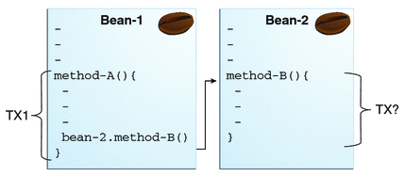
Bean Transactions

Slide 76
Transactions attributes
Required Attribute (Default)- If the client is running within a transaction and invokes the enterprise bean’s method, the method executes within the client’s transaction. If the client is not associated with a transaction, the container starts a new transaction before running the method.
Required New Attribute - If the client is running within a transaction and invokes the enterprise bean’s method, the container takes the following steps:
Suspends the client’s transaction
Starts a new transaction
Delegates the call to the method
Resumes the client’s transaction after the method completes
If the client is not associated with a transaction, the container starts a new transaction before running the method.

Slide 77
Transactions attributes
Mandatory Attribute - If the client is running within a transaction and invokes the enterprise bean’s method, the method executes within the client’s transaction. If the client is not associated with a transaction, the container throws a TransactionRequiredException.
NotSupported Attribute - If the client is running within a transaction and invokes the enterprise bean’s method, the container suspends the client’s transaction before invoking the method. After the method has completed, the container resumes the client’s transaction.

Slide 78
Transactions attributes
Supports Attribute - If the client is running within a transaction and invokes the enterprise bean’s method, the method executes within the client’s transaction. If the client is not associated with a transaction, the container does not start a new transaction before running the method.
Never Attribute - If the client is running within a transaction and invokes the enterprise bean’s method, the container throws a RemoteException. If the client is not associated with a transaction, the container does not start a new transaction before running the method.

Slide 79
Transactions Attributes
Transaction Attribute | Client’s Transaction | Business Method’s Transaction
Required | None | T2
Required | T1 | T1
RequiresNew | None | T2
RequiresNew | T1 | T2
Mandatory | None | Error
Mandatory | T1 | T1
NotSupported | None | None
NotSupported | T1 | None
Supports | None | None
Supports | T1 | T1
Never | None | None
Never | T1 | Error

Slide 80
Transactions Attributes
Transaction Attribute | TransactionAttributeType Constant
Required | TransactionAttributeType.REQUIRED
RequiresNew | TransactionAttributeType.REQUIRES_NEW
Mandatory | TransactionAttributeType.MANDATORY
NotSupported | TransactionAttributeType.NOT_SUPPORTED
Supports | TransactionAttributeType.SUPPORTS
Never | TransactionAttributeType.NEVER
@TransactionAttribute(REQUIRES_NEW)
public void firstMethod() {...}
@TransactionAttribute(REQUIRED)
public void secondMethod() {...}

Slide 81
Transaction Timeouts
For container-managed transactions, you can use the Administration Console to configure the transaction timeout interval.
For enterprise beans with bean-managed JTA transactions, you invoke the setTransactionTimeout method of the UserTransaction interface.

Slide 82


Summary
ORM Frameworks maps DB tables to classes
Provide API for queries and CRUD operations
JPA + Hibernate is ORM framework for Java
EntityManager provides CRUD + queries
EntityManagerFactory emf = Persistence
.createEntityManagerFactory("blog-db");
EntityManager em = emf.createEntityManager();
User user = em.find(User.class, 1L);

Slide 83
EJB, JPA and Hibernate
https://softuni.bg/courses/software-technologies

Slide 84






Free Trainings @ Software University
Software University Foundation – softuni.org
Software University – High-Quality Education, Profession and Job for Software Developers
softuni.bg
Software University @ Facebook
facebook.com/SoftwareUniversity
Software University @ YouTube
youtube.com/SoftwareUniversity
Software University Forums – forum.softuni.bg

